Slide 1
Part I: Corporate Social Responsibility
Chapter 1: What Is CSR?

Slide 2
What Is CSR?
What is the purpose of the for-profit firm?
What is the relationship between a firm and the societies in which it operates?
What responsibility does a firm owe society to self-regulate its actions in pursuit of profit?

Slide 3
What Is CSR?
A new definition of CSR:
A responsibility among firms to meet the needs of their stakeholders and a responsibility among stakeholders to hold firms to account for their actions

Slide 4
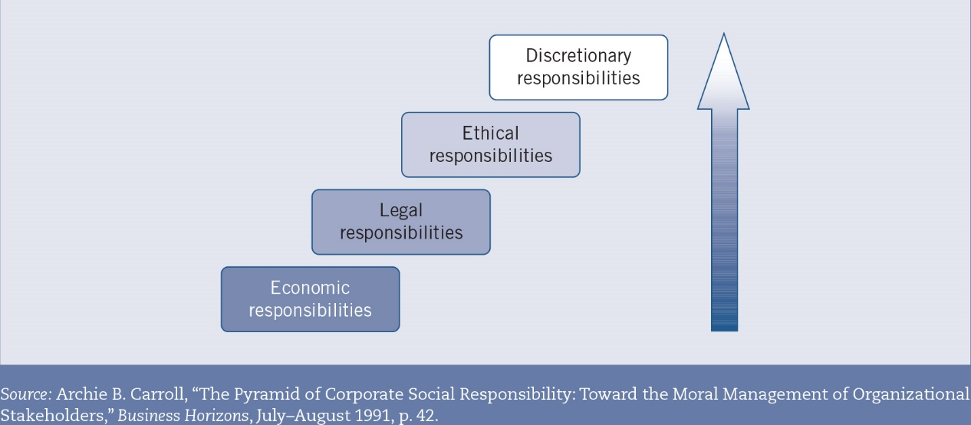
The CSR Hierarchy

Slide 5
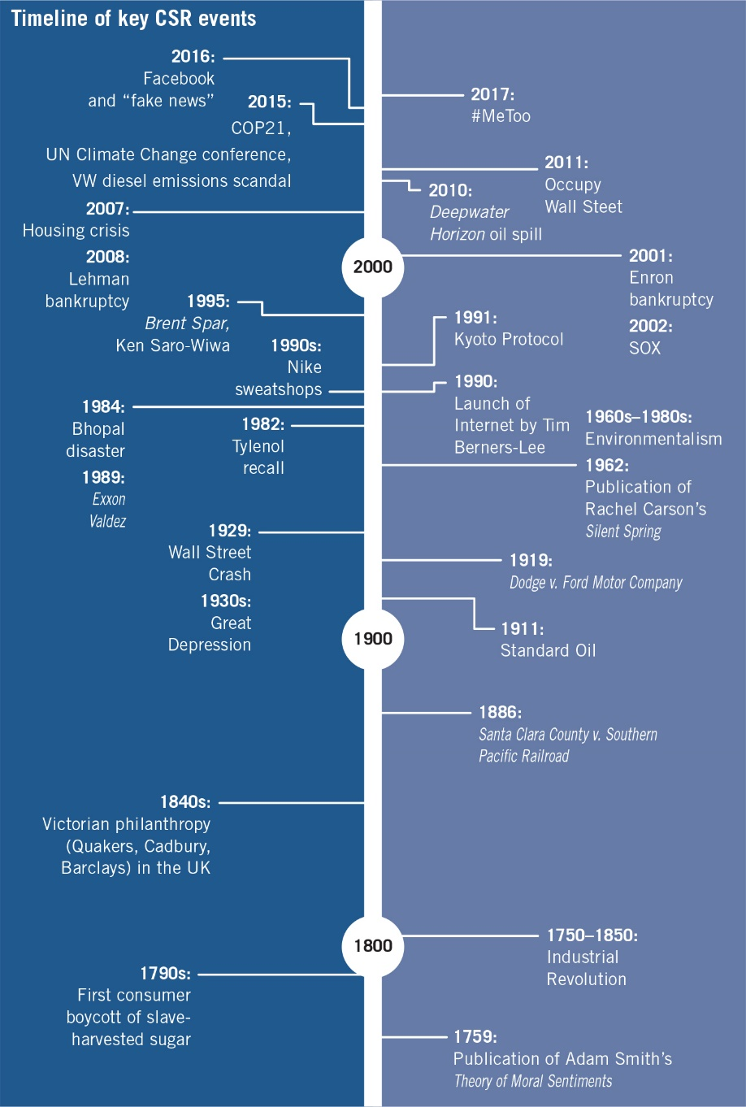
The Evolution of CSR

Slide 6
Foundations of CSR
An ethical argument for CSR:
CSR is an argument based on two forms of ethical reasoning--consequentialist (utilitarian) and categorical (Kantian). Consequentialist reasoning justifies action in terms of the outcomes generated (the greatest good for the greatest number of people), while categorical reasoning justifies action in terms of the principles by which that action is carried out (the application of core ethical principles, regardless of the outcomes).

Slide 7
Foundations of CSR
A moral argument for CSR:
CSR is an argument of moral reasoning that reflects the relationship between a company and the society within which it operates. It assumes firms recognize that they do not exist in a vacuum and that their ability to operate and achieve success comes as much from societal resources (e.g., infrastructure, rule of law, educated employees) and consent (e.g., social contract, license to operate) as it does from internal factors.

Slide 8
Foundations of CSR
A rational argument for CSR:
CSR is a rational argument that focuses on the benefits
to performance of avoiding external constraints. Adopting the path of least resistance with regard to issues of
concern makes common and business sense. In today’s globalized world, where firms are empowered to enact change, CSR represents a means of anticipating and reflecting societal concerns to minimize operational and financial sanctions.

Slide 9
Foundations of CSR
An economic argument for CSR:
CSR is an argument of economic self-interest for business. CSR adds value because it allows firms to reflect the needs and concerns of their various stakeholder groups. By doing so, the firm is more likely to create greater value and, as a result, retain the loyalty of those stakeholders. Simply put, CSR is a way of matching corporate operations with stakeholder values and expectations that are constantly evolving.

Slide 10
Strategic CSR Debate
Motion:
There are no absolute ethical or moral standards.

Slide 11
Questions for Discussion and Review
What is the purpose of the for-profit firm? What value does it create for society?
Define corporate social responsibility. What arguments in favor of CSR seem most important to you? Are these factors prevalent among firms today, or are they rare?
What are the four responsibilities of a firm outlined in Archie Carroll’s pyramid of CSR model? Illustrate your definitions of each level with corporate examples.
Milton Friedman stated that “few trends could so thoroughly undermine the very foundations of our free society as the acceptance by corporate officials of a social responsibility other than to make as much money for their stockholders as possible.” What are two arguments in support of his assertion and two against?
Why does this book favor the economic argument for CSR? Why is this argument better than the ethical, moral, or rational arguments for CSR? Do you agree?

